Slide 1

Chapter 20
Remote Login:
TELNET
and
SSH
Copyright © The McGraw-Hill Companies, Inc. Permission required for reproduction or display.

Slide 2
OBJECTIVES:
To introduce the TELNET protocol and show how it implements local and remote login.
To discuss options and sub-options used in TELNET and how they are negotiated.
To define out-of-band signaling in TELNET.
To define different modes of operations in TELNET.
To introduce SSH as an alternative to TELNET.
To show how different components of SSH are combined to provide a secure connection over an insecure TCP connection.
To discuss port-forwarding in SSH and how it can be used to provide security for other applications.

Slide 3
Chapter
Outline
20.1 TELNET
20.2 Secure Shell (SSH)

Slide 4
20-1 TELNET
TELNET is an abbreviation for TErminaL NETwork. It is the standard TCP/IP protocol for virtual terminal service as proposed by ISO. TELNET enables the establishment of a connection to a remote system in such a way that the local terminal appears to be a terminal at the remote system.

Slide 5
Topics Discussed in the Section
Concepts
Time-Sharing Environment
Network Virtual Terminal (NVT)
Embedding
Options and Suboption Negotiation
Controlling the Server
Out-of-Band Signaling
Escape Character
Modes of Operation
User Interface
Security Issue

Slide 6

Note
TELNET is a general-purpose
client-server application program.

Slide 7
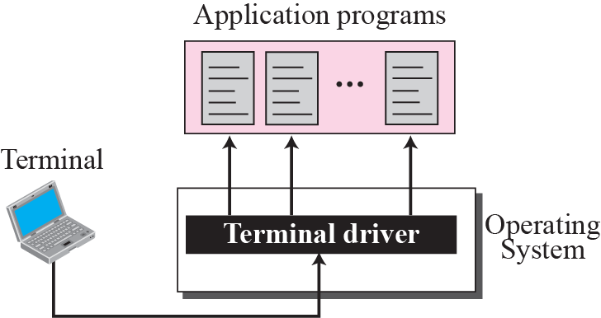
Figure 20.1 Local login

Slide 8
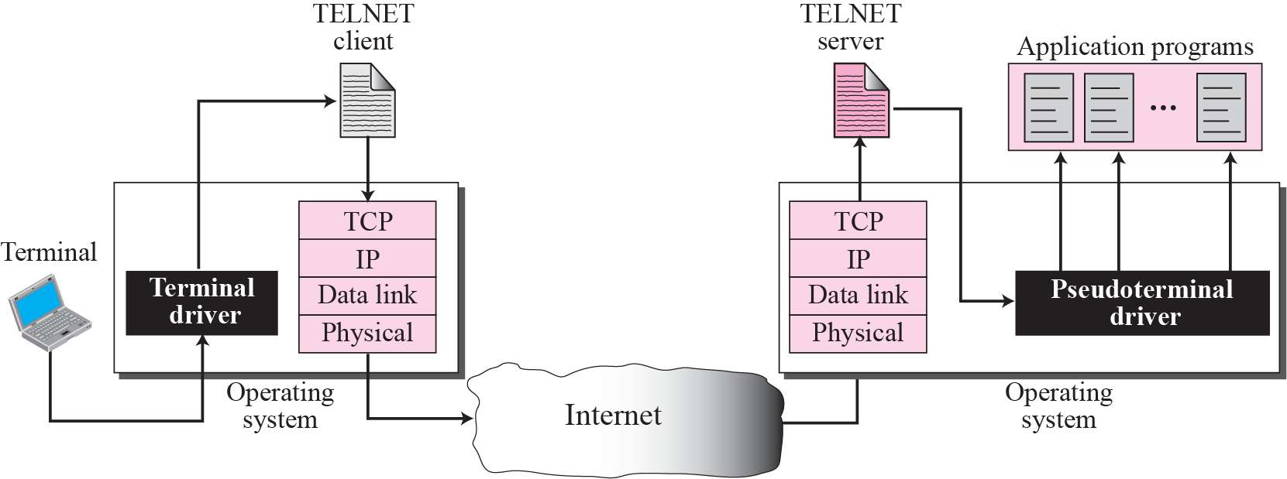
Figure 20.2 Remote login

Slide 9
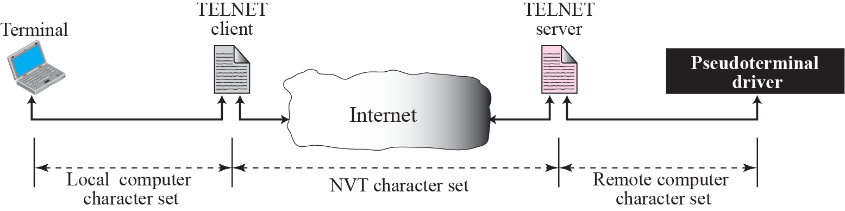
Figure 20.3 Concept of NVT

Slide 10
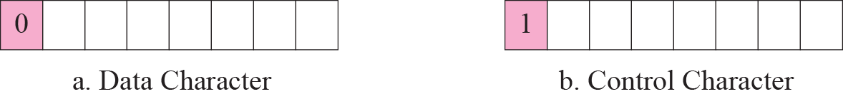
Figure 20.4 Format of data and control characters

Slide 11
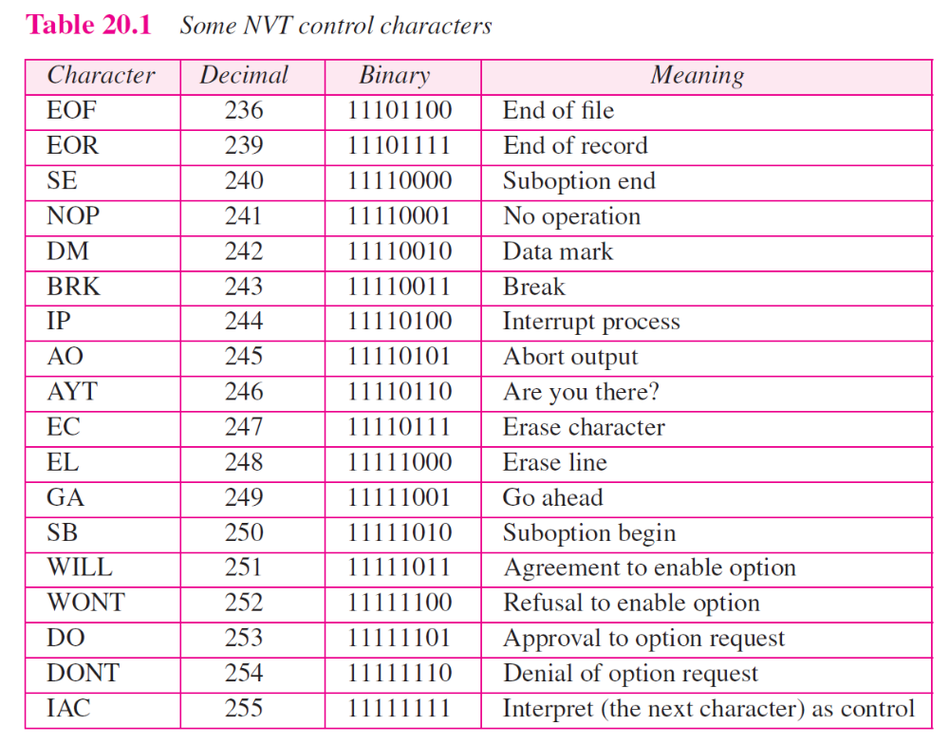

Slide 12
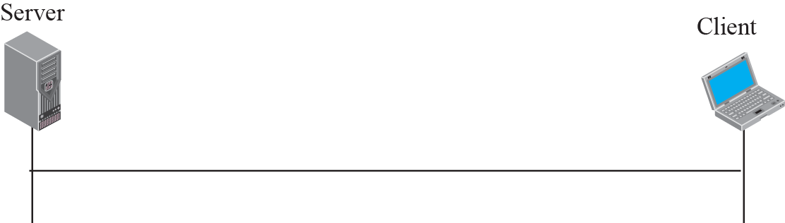
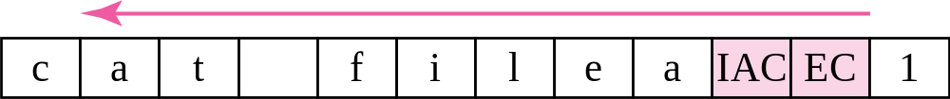
Figure 20.5 An example of embedding

Slide 13
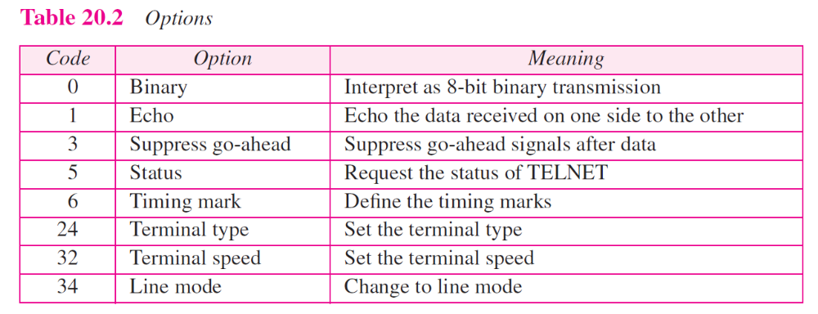

Slide 14
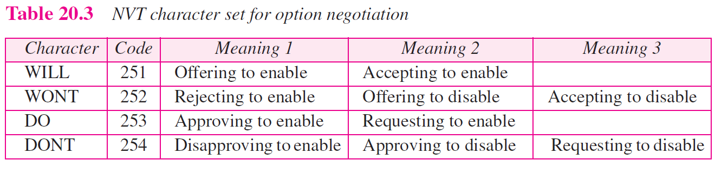

Slide 15
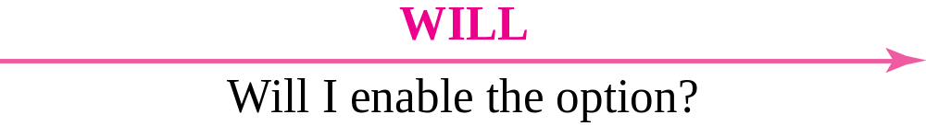
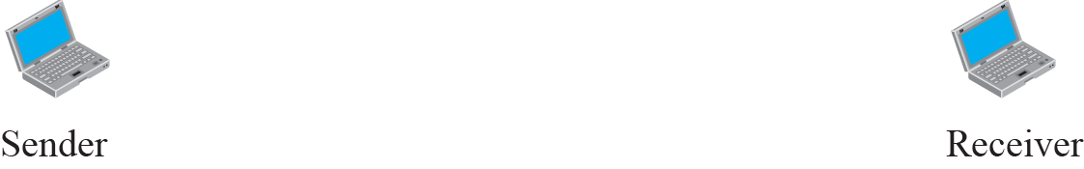

Figure 20.6 Offer to enable an option

Slide 16

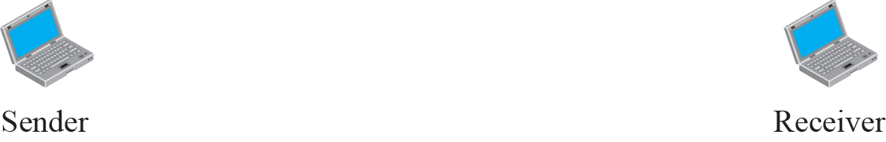

Figure 20.7 Request to enable an option

Slide 17


Figure 20.8 Offer to disable an option

Slide 18


Figure 20.9 Request to disable an option

Slide 19
Example 20.1
Figure 20.10 shows an example of option negotiation. In this example, the client wants the serverto echo each character sent to the server. In other words, when a character is typed at the user keyboard terminal, it goes to the server and is sent back to the screen of the user before being processed. The echo option is enabled by the server because it is the server that sends the characters back to the user terminal. Therefore, the client should request from the server the enabling of the option using DO. The request consists of three characters: IAC, DO, and ECHO. The server accepts the request and enables the option. It informs the client by sending the three-character approval: IAC, WILL, and ECHO.

Slide 20
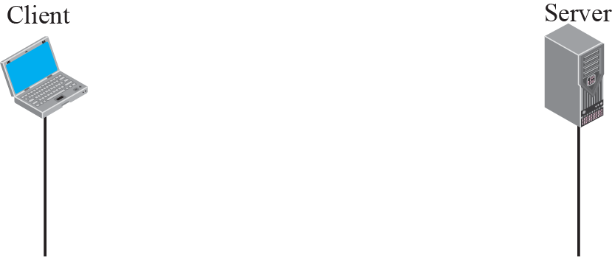
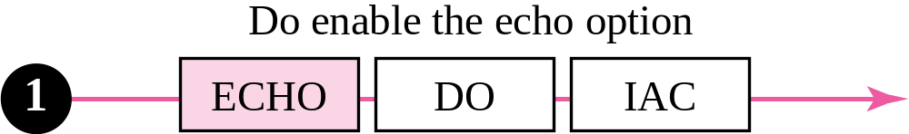
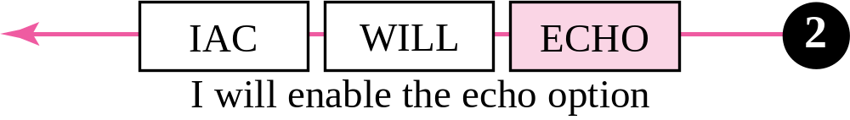
Figure 20.10 Example 20.1: Echo option

Slide 21
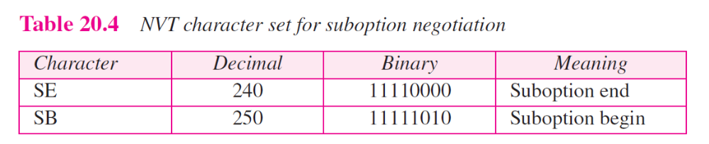

Slide 22
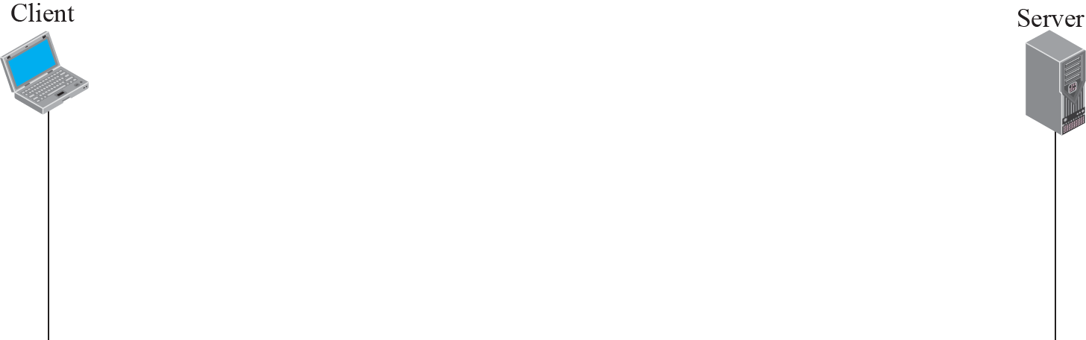
Figure 20.11 Example of sub-option negotiation

Slide 23
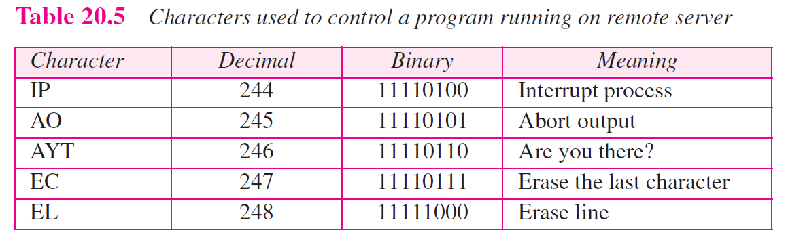

Slide 24
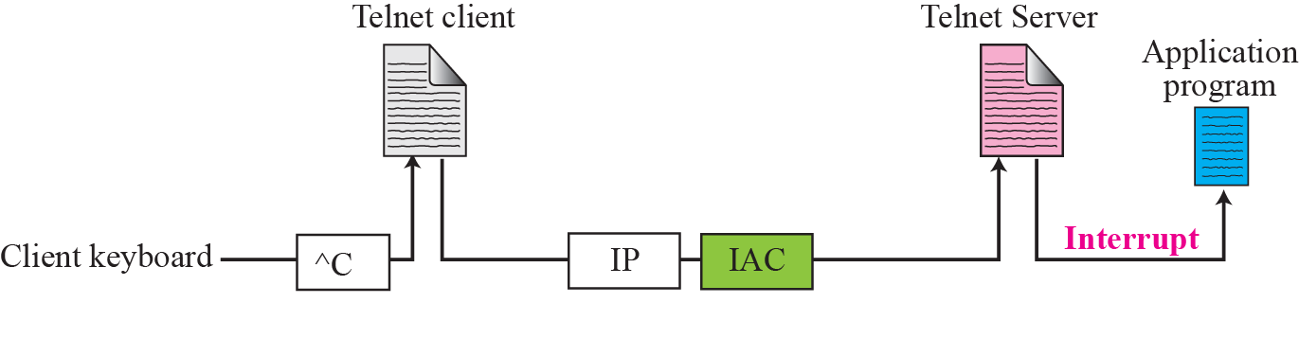
Figure 20.12 Example of interrupting an application program

Slide 25
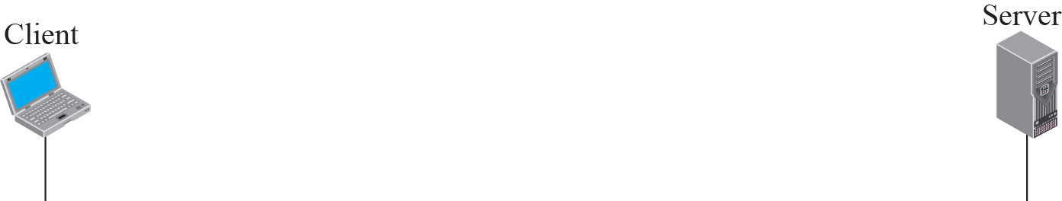
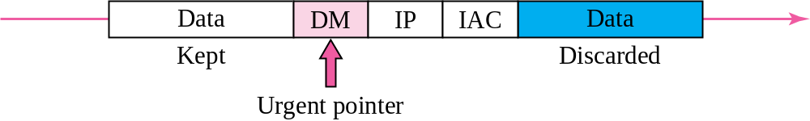
Figure 20.13 Out-of-band signaling

Slide 26
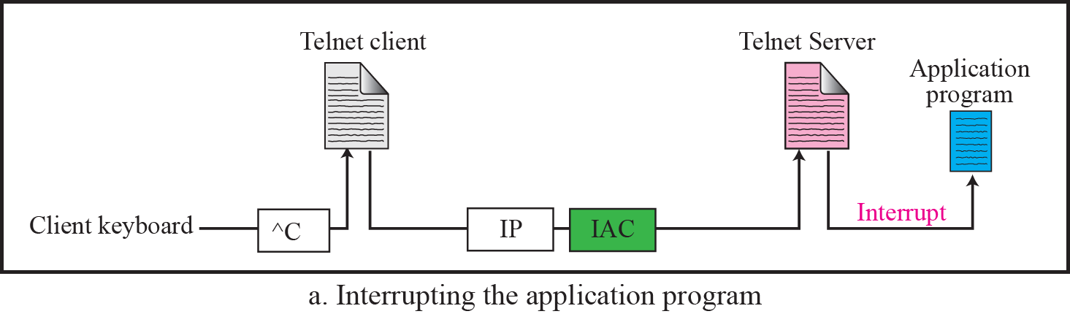
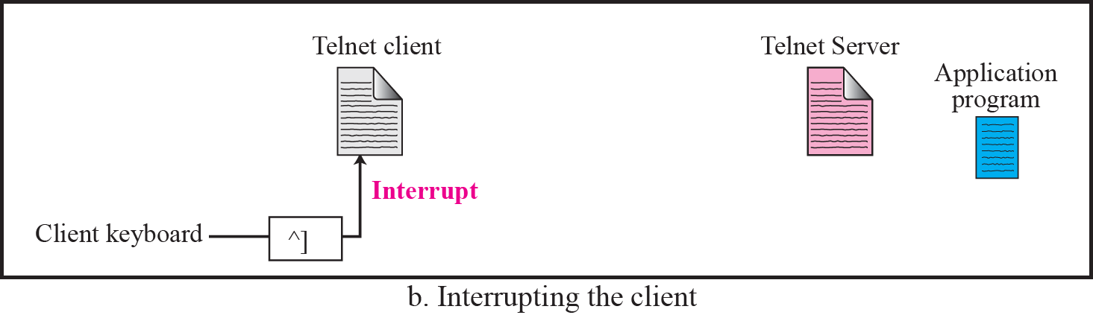
Figure 20.14 Two different interruptions

Slide 27
Example 20.2
In this example, we use the default mode to show the concept and its deficiencies even though it is almost obsolete today. The client and the server negotiate the terminal type and terminal speed and then the server checks the login and password of the user (see Figure 20.15).

Slide 28
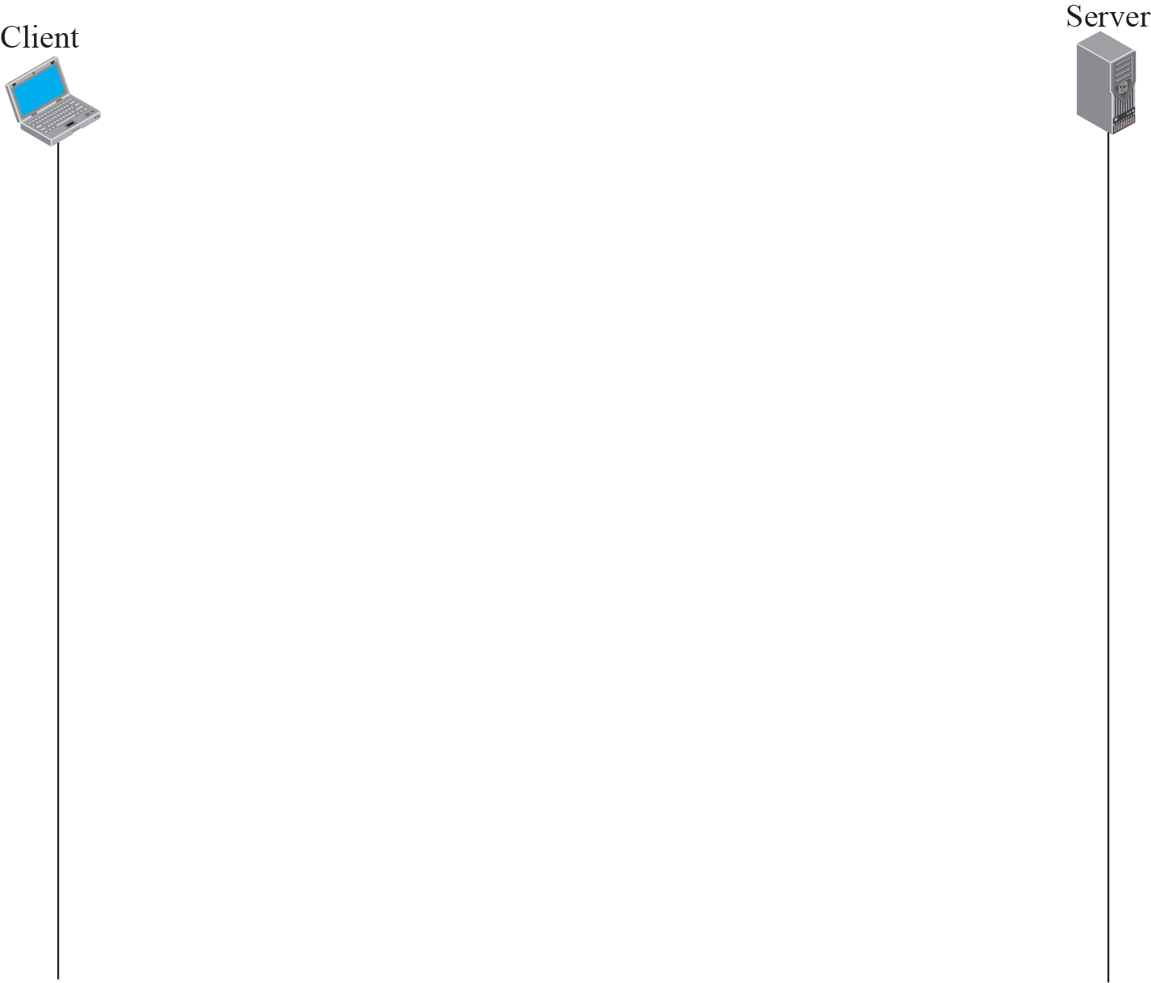
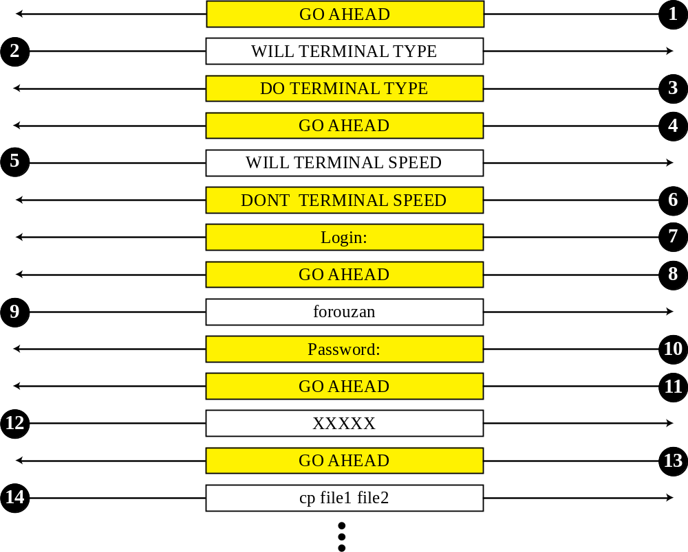
Figure 20.15 Example 20.2

Slide 29
Example 20.3
In this example, we show how the client switches to the character mode. This requires that the client request the server to enable the SUPPRESS GO AHEAD and ECHO options (see Figure 20.16).

Slide 30
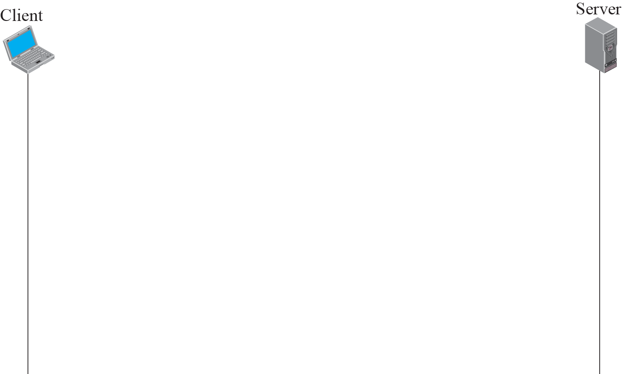
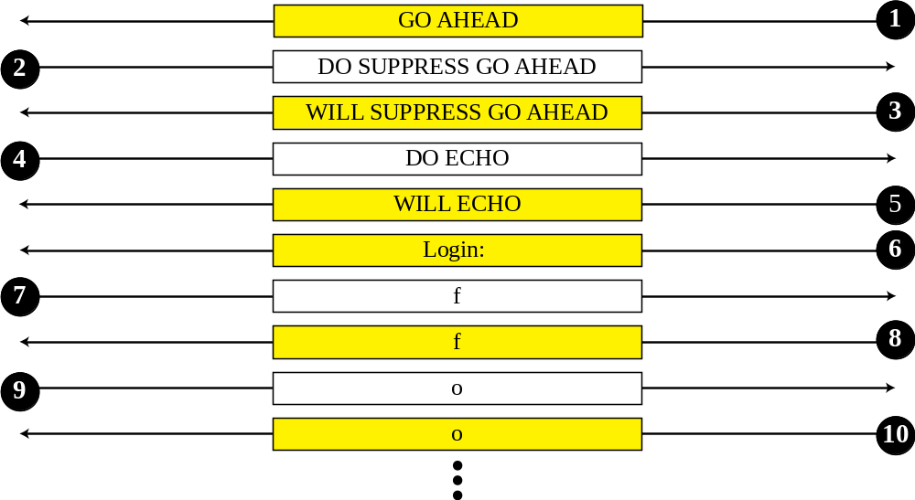
Figure 20.16 Example 20.3

Slide 31
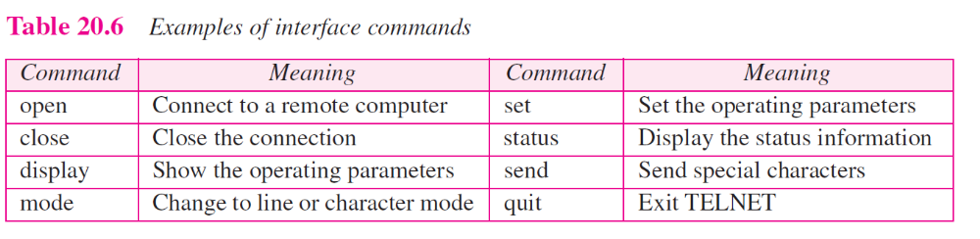

Slide 32
20-2 SECURE SHELL (SSH)
Another popular remote login application program is Secure Shell (SSH). SSH, like TELNET, uses TCP as the underlying transport protocol, but SSH is more secure and provides more services than TELNET.

Slide 33
Topics Discussed in the Section
Versions
Components
Port Forwarding
Format of the SSH Packet

Slide 34
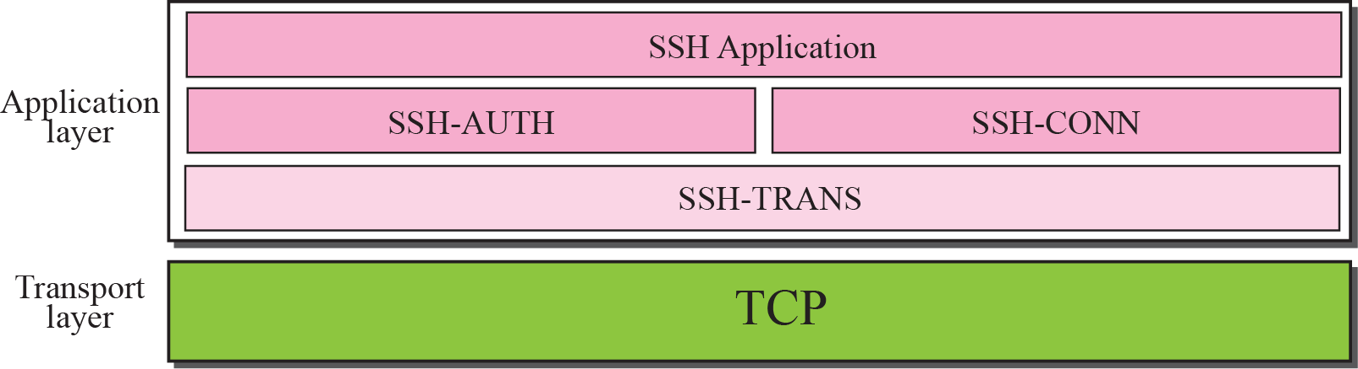
Figure 20.17 Components of SSH

Slide 35
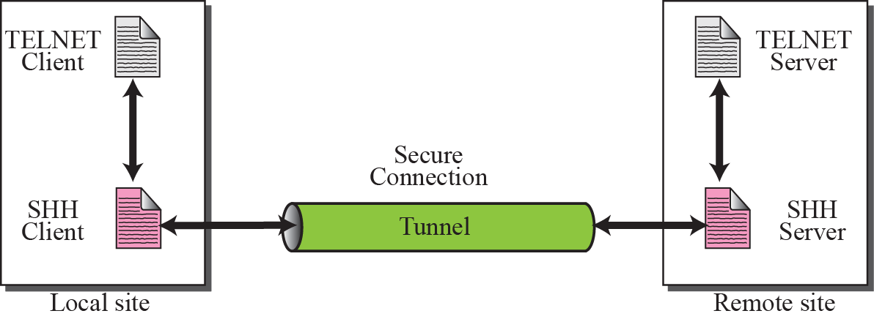
Figure 20.18 Port forwarding

Slide 36
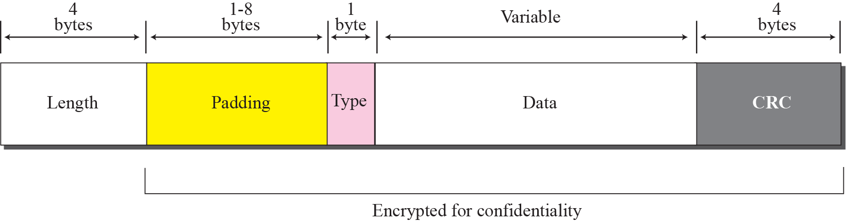
Figure 20.19 SSH packet format

